Slide 1
High-Velocity IT (HVIT) & Digital Organizations
Importance in ITIL 4
Digital transformation and objectives

Slide 2
What is HVIT?
Application of digital tech for business enablement
Speed matters: time to market, time to customer, time to change
Not always faster = better; depends on organizational context
Applies across the service value chain

Slide 3
Importance in ITIL 4
Aligns IT with high-velocity business needs
Supports innovation → development → operations → value realization
Uses ITIL building blocks for efficient HVIT operating model
Ensures fast flow, feedback, and improvement

Slide 4
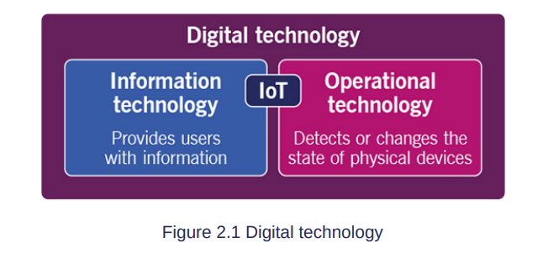

Slide 5
Digital Technology vs Digital Organization
Digital Technology:
- IT: data processing, information systems, software
- OT: controls physical devices, IoT-enabled
Digital Organization:
- Strategic use of digital tech in products, services, processes
- Digital-first culture: affects customer & employee experience
- Differentiates business competitively

Slide 6
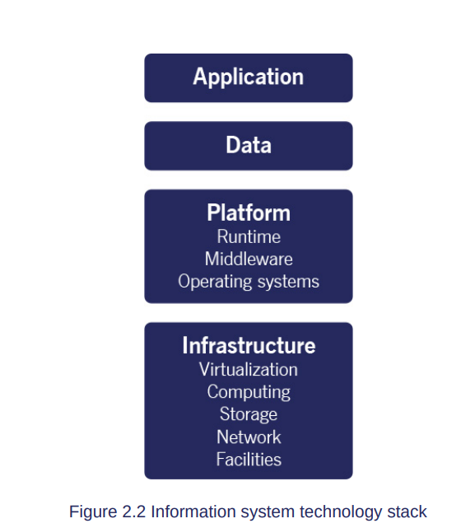

Slide 7
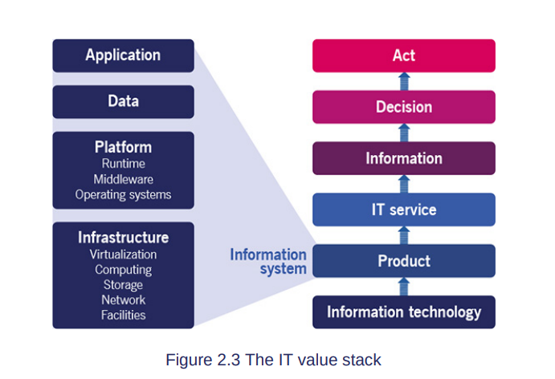

Slide 8
Digital Transformation
Doing things differently or doing different things with digital tech
Major improvement in objectives not feasible by non-digital means
May include IT transformation: restructuring IT to integrate with business
Can be incremental or major shifts

Slide 9
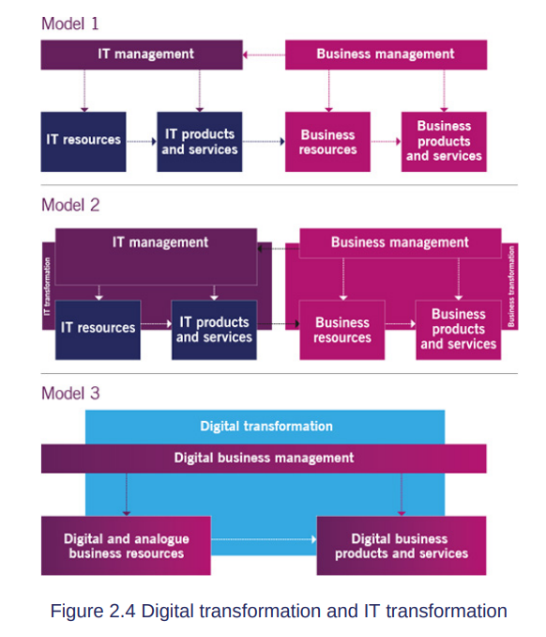

Slide 10
HVIT Objectives
1. Valuable investments – strategic IT application
2. Fast development – rapid delivery of services/products
3. Resilient operations – reliable IT performance
4. Co-created value – effective provider-consumer collaboration
5. Assured conformance – meet governance, risk, compliance

Slide 11
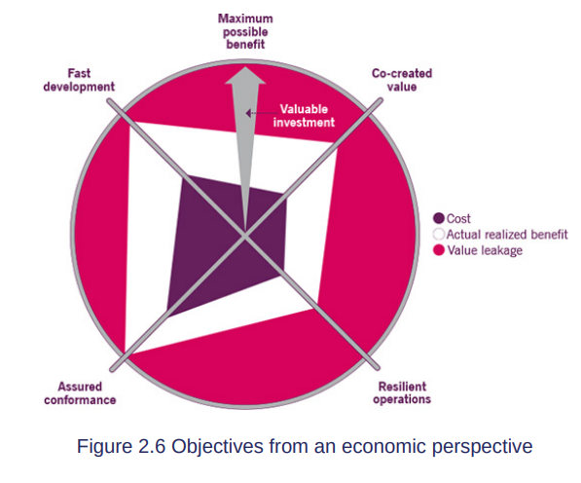

Slide 12
HVIT Key Characteristics
Lean: Reduce waste, improve throughput, small batch work
Agile: Iterative development, feedback-driven, cross-functional teams
Resilient: Minimize incident impact, quick recovery, SRE/DevOps
Continuous: CI/CD, automation of build/test/deploy

Slide 13
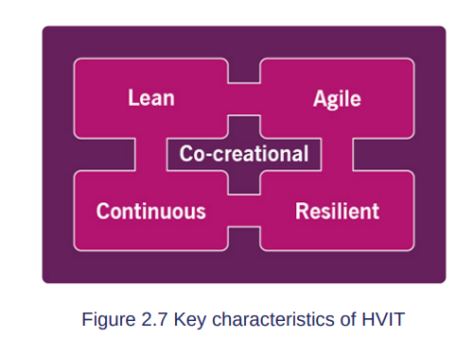

Slide 14
Lean & Agile Explained
Lean: Small batches, Kanban boards, reduce WIP, identify bottlenecks
Agile: Frequent iterations, backlog prioritization, cost of delay
DevOps: Collaboration between dev & ops, automates repetitive tasks

Slide 15
Resilient & Continuous
Resilient: SRE, DevOps, microservices, disaster recovery
Continuous: CI/CD, build automation, test automation, deployment automation
Small & frequent changes = faster value, lower risk

Slide 16
Co-creation & Value
HVIT characteristics → co-creation of value
Service-dominant logic: Value created with consumers, not just delivered
Focus: customer outcomes, effective service interaction

Slide 17
Digital Products & Lifecycles
Digital product: Tech is essential to product/service
Lifecycle: Explore → Engage → Onboard → Co-create → Realize → Offboard → Retired
Band of visibility: balance what provider/consumer sees

Slide 18
Explore 🔍
Meaning: This is the research and discovery stage. You look for opportunities, problems to solve, or new ideas.
Key points:
Identify what users need.
Understand market trends or technology options.
Evaluate feasibility (can we actually do it?).
Example: A company wants to create a new app feature. They survey users to see what they like or need.

Slide 19
Engage 🤝
Meaning: Start talking and involving stakeholders (users, managers, team). This helps define what’s important.
Key points:
Discuss ideas with users and internal teams.
Gather early feedback to guide development.
Example: Show the app prototype to a few users and ask: “Do you like this feature? Would it help you?”

Slide 20
Onboard 🚀
Meaning: Prepare everything so the service or technology is ready to start being used.
Key points:
Set up systems and tools.
Train users or team members.
Make sure everyone knows how to use it.
Example: The new app feature is installed for users, and a short guide shows them how it works.

Slide 21
Co-create 🛠️
Meaning: Work with users to improve the service. Their feedback is used to enhance it.
Key points:
Iterate and update based on real usage.
Collaborate with users to make the product better.
Example: Users suggest a faster loading button, and the team improves the app accordingly.

Slide 22
Realize 💡
Meaning: The service starts delivering value. Users get the benefits it was designed for.
Key points:
Monitor performance.
Measure how well it meets user needs.
Example: Users are now using the app feature regularly, and their tasks are completed faster.

Slide 23
Offboard 🛑
Meaning: Gradually remove or replace the service when it’s no longer needed or is being upgraded.
Key points:
Help users transition smoothly.
Move data or resources if required.
Example: An old version of the app feature is removed, and users are guided to use the new version.

Slide 24
Retired 🗑️
Meaning: The service is fully retired. It’s no longer active or supported.
Key points:
Archive or delete data safely.
Learn lessons for future services.
Example: The old app feature is removed permanently, and the team documents what they learned for future projects.

Slide 25
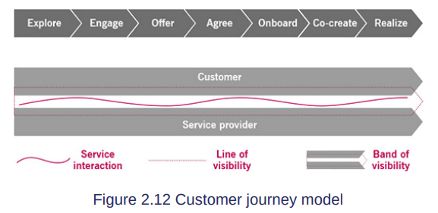
Explore 🔍 → Engage 🤝 → Onboard 🚀 → Co-create 🛠️ → Realize 💡 → Offboard 🛑 → Retired 🗑️
(Idea) (Plan) (Start) (Improve) (Benefit) (Transition) (Done)

Slide 26
Summary
HVIT = Speed + Value + Resilience + Collaboration
Digital organizations leverage HVIT to achieve strategic advantage
Objectives and characteristics of HVIT guide ITIL-aligned operations
Digital transformation = foundation for high-velocity, digitally-enabled businesses

Slide 27
What is Culture in HVIT?
Shared values, behaviors and mindset in an organization
Influences how people make decisions
Supports innovation, trust and learning
Without right culture, speed becomes chaos

Slide 28
Culture

Slide 29
3.1 Five Key Behaviour Patterns
1. Accept ambiguity and uncertainty
2. Trust and be trusted
3. Continually raise the bar
4. Help get customers’ jobs done
5. Commit to continual learning

Slide 30
Accept Ambiguity and Uncertainty
Digital world is unpredictable
Not all information is available
Take calculated risks
Adapt quickly instead of waiting for perfection

Slide 31
Trust and Be Trusted
Reduces micromanagement
Encourages open communication
Supports collaboration and speed
Builds psychological safety

Slide 32
Continually Raise the Bar
Always improve quality and performance
Focus on innovation and excellence
Never settle for ‘good enough’

Slide 33
Help Get Customers’ Jobs Done
Focus on customer outcomes, not just output
Understand real customer problems
Deliver value that helps achieve goals

Slide 34
Commit to Continual Learning
Learn from failure and success
Encourage experimentation
Upgrade skills continuously
Share knowledge across teams

Slide 35
3.2.1 Purpose
Purpose = External goal that drives effort
Connects technology to real-world impact
Ensures responsible and meaningful work

Slide 36
Ethics in HVIT
Moral principles guiding technology use
Ensure fairness, transparency and accountability
Protect data privacy and society
Build trust with customers

Slide 37
Ethics Subtopics
Techno-ethics (impact of technology on society)
Ethics in Artificial Intelligence
Habits and role of failure
Education and awareness
Organizational design supporting accountability

Slide 38
Design Thinking
Human-centered problem solving approach
Focus on understanding user needs
Encourages innovation and experimentation

Slide 39
Design Thinking Steps
1. Empathize (understand user)
2. Define problem clearly
3. Ideate possible solutions
4. Prototype small version
5. Test and improve

Slide 40
3.2.2 People
Organizing knowledge work effectively
Creating healthy and productive workplace
Supporting agility and collaboration

Slide 41
Reconstructing for Service Agility
Flexible team structures
Cross-functional teams
Organize around services and value delivery
Faster decision-making

Slide 42
Safety Culture
Psychological safety
No blame environment
Encourage reporting mistakes
Promotes learning and innovation

Slide 43
Stress Prevention
Prevent unhealthy tension and burnout
Support work-life balance
Sustainable high performance
Monitor and manage workload

Slide 44
3.2.3 Progress
Focus on improvement in complex environments
Use experimentation and learning
Encourage lean thinking and structured improvement

Slide 45
Working in Complex Environments
Cause and effect not always clear
Use safe-to-fail experiments
Identify multiple hypotheses
Amplify positive results, reduce negative impact

Slide 46
Lean Culture
Eliminate waste
Improve continuously
Use fast feedback loops
Focus only on value-adding activities

Slide 47
Cynefin Framework Domains
Clear – Apply best practices
Complicated – Use expert analysis
Complex – Experiment and learn
Chaotic – Act immediately to stabilize
Confused – Not sure which domain applies

Slide 48
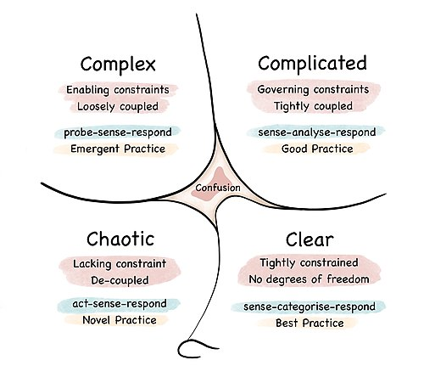

Slide 49
ITIL Continual Improvement Model
Structured improvement approach
Applies to whole service value system
Iterative and incremental
Everyone participates in improvement

Slide 50
7 Steps of Continual Improvement
1. What is the vision?
2. Where are we now?
3. Where do we want to be?
4. How do we get there?
5. Take action
6. Did we get there?
7. How do we keep momentum?

Slide 51
Improvement Domains
Improve products and services
Improve management practices
Improve the continual improvement practice itself
Improvement is everyone’s responsibility.

Slide 52
Toyota Kata
Scientific thinking model for improvement
Step-by-step experimentation
Practice and coaching to build habits
Reduces wrong assumptions

Slide 53
Toyota Kata – 5 Questions
What are we trying to achieve?
Where are we now?
What obstacle is in the way?
What is our next step?
When will we review what we learned?

Slide 54
Toyota Kata – 4 Steps
Understand direction
Grasp current condition
Set next target condition
Experiment toward target condition

Slide 55
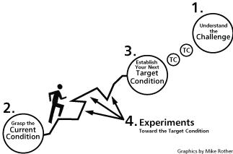

Slide 56
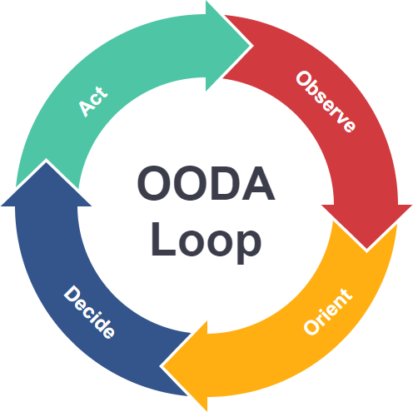

Slide 57
OODA Loop
Observe – Collect information
Orient – Analyze and interpret
Decide – Choose action
Act – Execute quickly
Repeat continuously

Slide 58
Why OODA is Important in HVIT
Faster than traditional PDCA
Originally used in military operations.
Useful in cybersecurity and fast industries
Supports agility and rapid response
Orientation influenced by experience and culture

Slide 59
🔷 Comparison: Toyota Kata vs OODA vs ITIL Model
Model | Focus
ITIL Continual Improvement | Structured improvement
Toyota Kata | Scientific habit-based improvement
OODA Loop | Rapid adaptive decision-making

Slide 60
FINAL QUICK REVISION SUMMARY
HVIT = Fast, adaptive, customer-focused IT
3.1 Behaviour Patterns – 5 key mindsets
3.2 Purpose – Ethics + Design Thinking
3.2 People – Agility, Safety, Stress control
3.2 Progress – Complexity, Lean, Improvement models
Improvement = Iterative, Experimental, Scientific

